Slide 1
Success Story: Python in University Education
By: Chetan Khatri
Principal Big Data Engineer, Nazara Technologies.
Data Science & Machine Learning Curricula Advisor, University of Kachchh, Gujarat.
Inspired by: Dr. Ajith Kumar, Scipy 2015 – IIT Bombay event
Thankful to : Prof. Devji Chhanga, Dept. of Computer Science, University of kachchh
Pycon India 2016

Slide 2


About KSKV Kachchh University, Gujarat
Located at Bhuj, Kachchh – Gujarat.

Slide 3
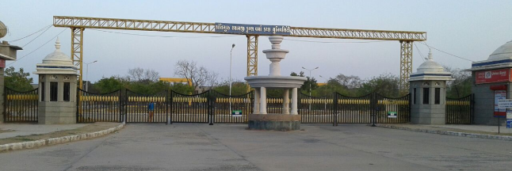
About KSKV Kachchh University, Gujarat
50+ Colleges are afflicted to University of Kachchh.
8+ Colleges are having Computer Science Department.
Around 2500+ Students.

Slide 4
Followed process
University agreed with “Remove Gap between Academia and Industry”
Started local Conference “PyKutch” in 2016.
Given multiple talks for Master programs at University of Kachchh.
Data Analytics with Numpy and Pandas with Jupyter Notebook.
Predictive Modeling with Python.
Role of AI, Computer Vision, Neural Network, Genetic Algorithm with Python.
Think Machine Learning with Scikit-learn (Python).
Opportunities in Data Science, Big Data with Python.
Helped University Dean to make Curricula.
Got approved from Vice – chancellor.

Slide 5
Result

Slide 6
Result
India's 1st Government granted University having Data Science in Curriculum.
Apache Hadoop
Apache Spark with Python
Apache Kafka
Machine Learning with Spark with Python
CCCS936 - Data Science
CCCS938 - Practical Based on CCCS936

Slide 7
How is it so easy ?
got approved Python in Data Structure & Algorithms to Big Data & Machine learning Syllabus in Government University.

Slide 8
How is it so easy ?
Make Subject Interesting for Student's ?
Give Use cases of Research and also from Industry for Python Subject.
Give them salary offered by companies matrix, if from same University student got placed in such company then it would be good example.
Let's have a use cases !

Slide 9
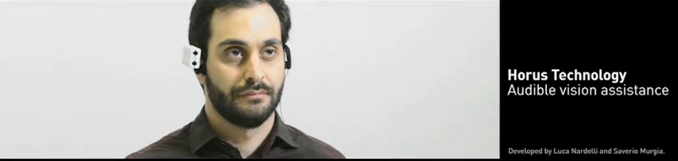
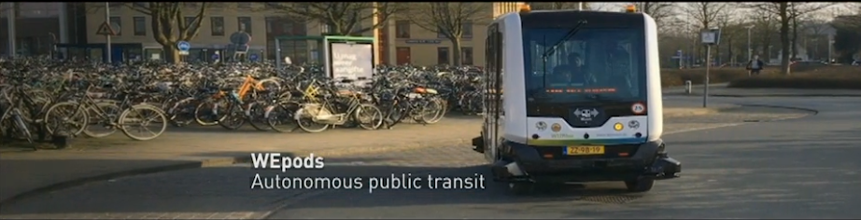
Machine Learning(i.e Artificial Intelligence)

Slide 10
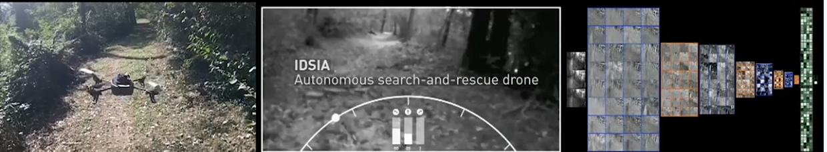
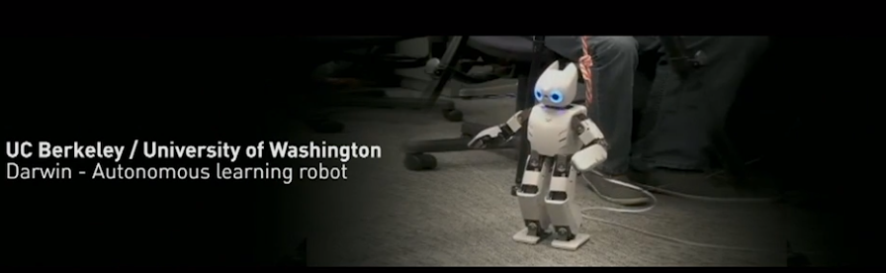
Machine Learning(i.e Artificial Intelligence) (Conti...)

Slide 11
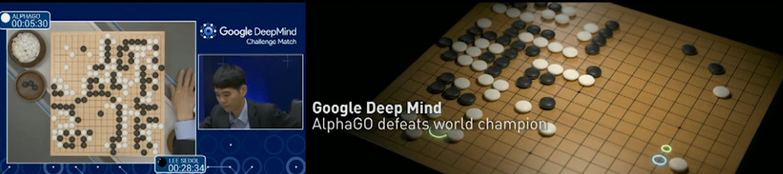
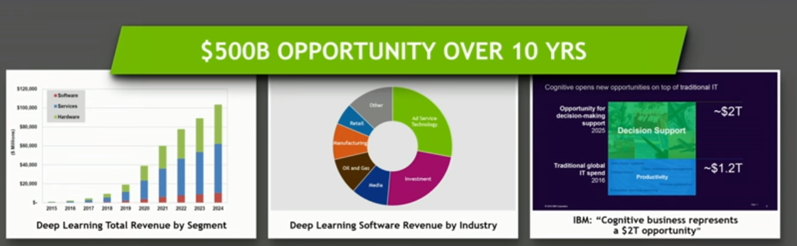
Machine Learning(i.e Artificial Intelligence) (Conti...)

Slide 12
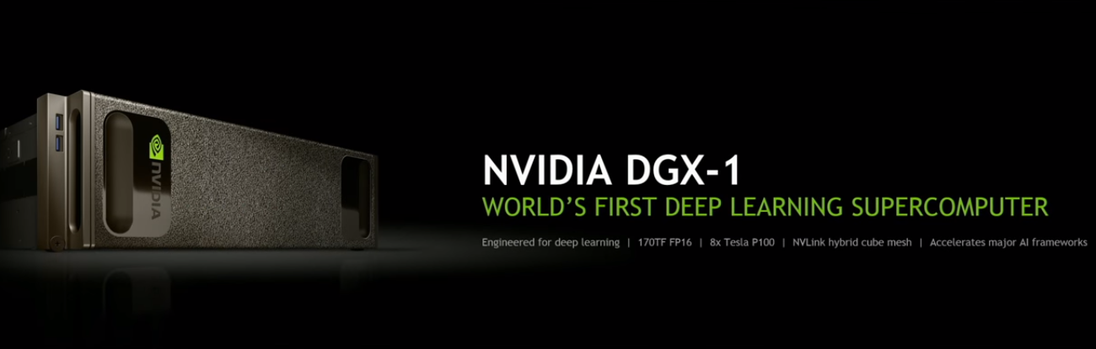
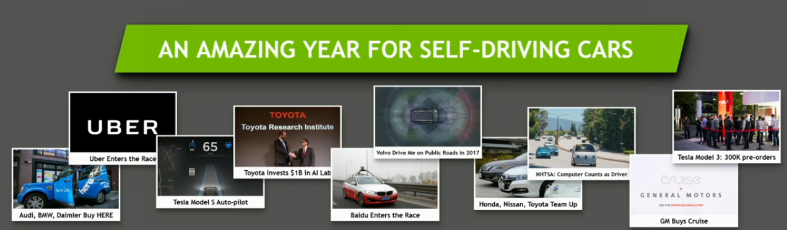
Machine Learning(i.e Artificial Intelligence) (Conti...)

Slide 13
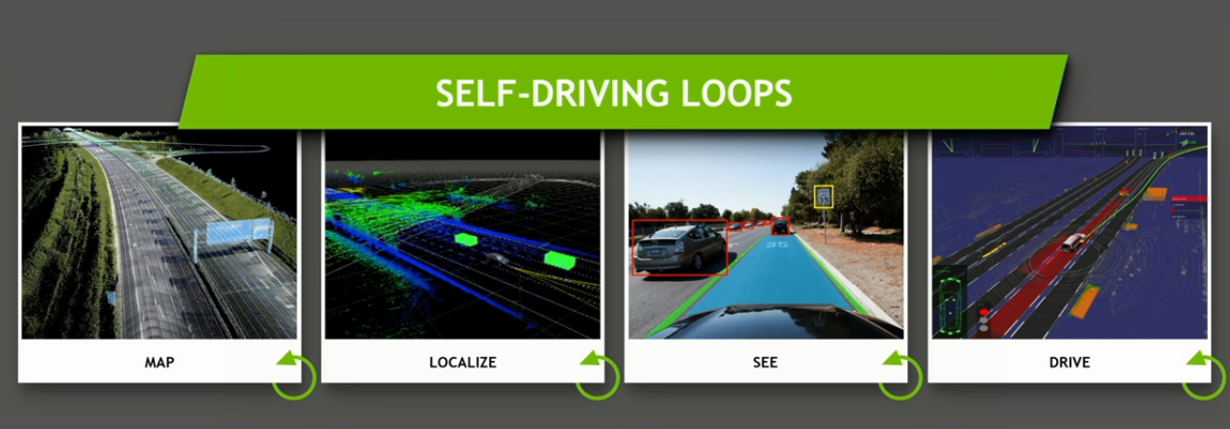
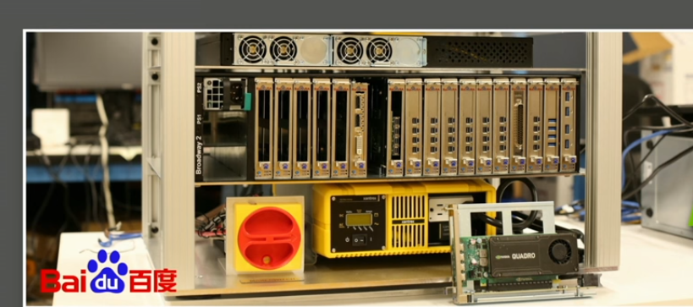
Machine Learning(i.e Artificial Intelligence) (Conti...)

Slide 14
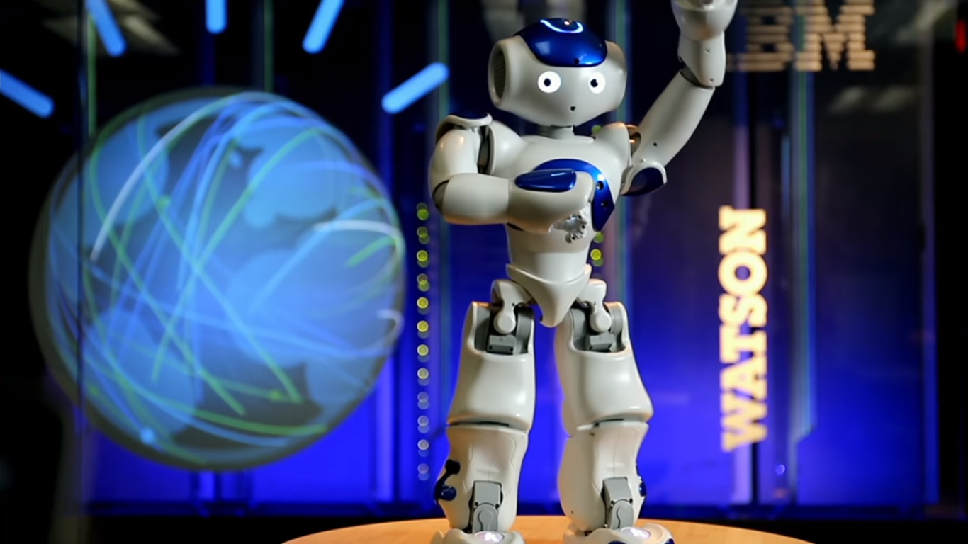
Q & A, Watson Robot

Slide 15
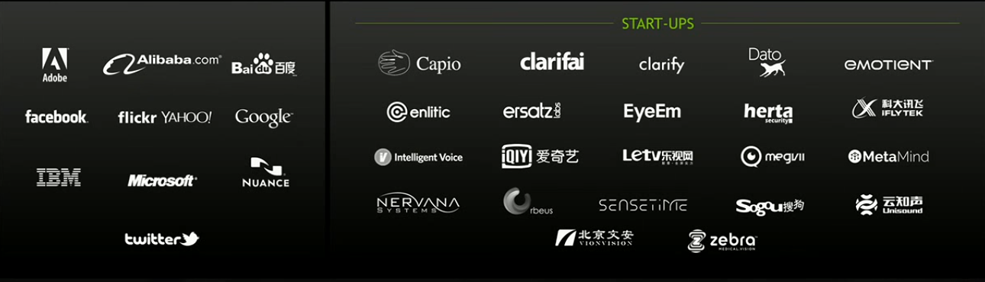
Opportunities

Slide 16
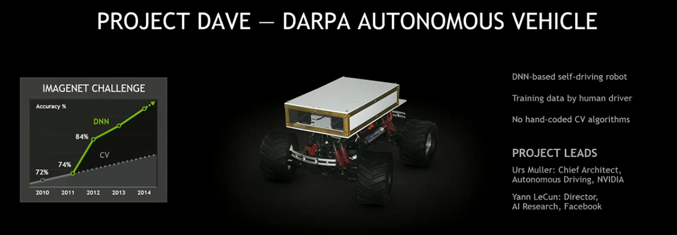
Try Prototype

Slide 17
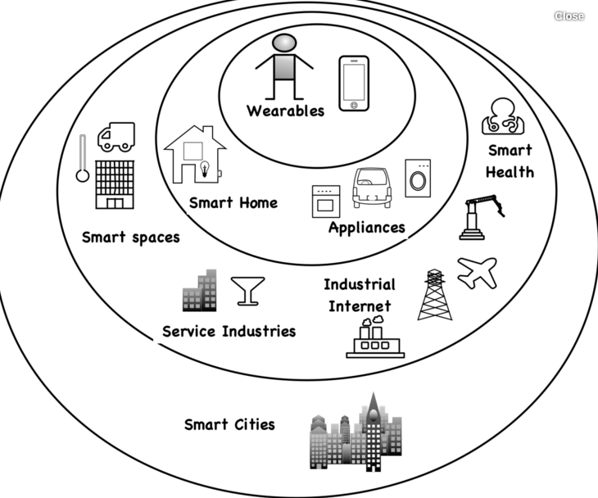
Interntet of Things (IoT)

Slide 18
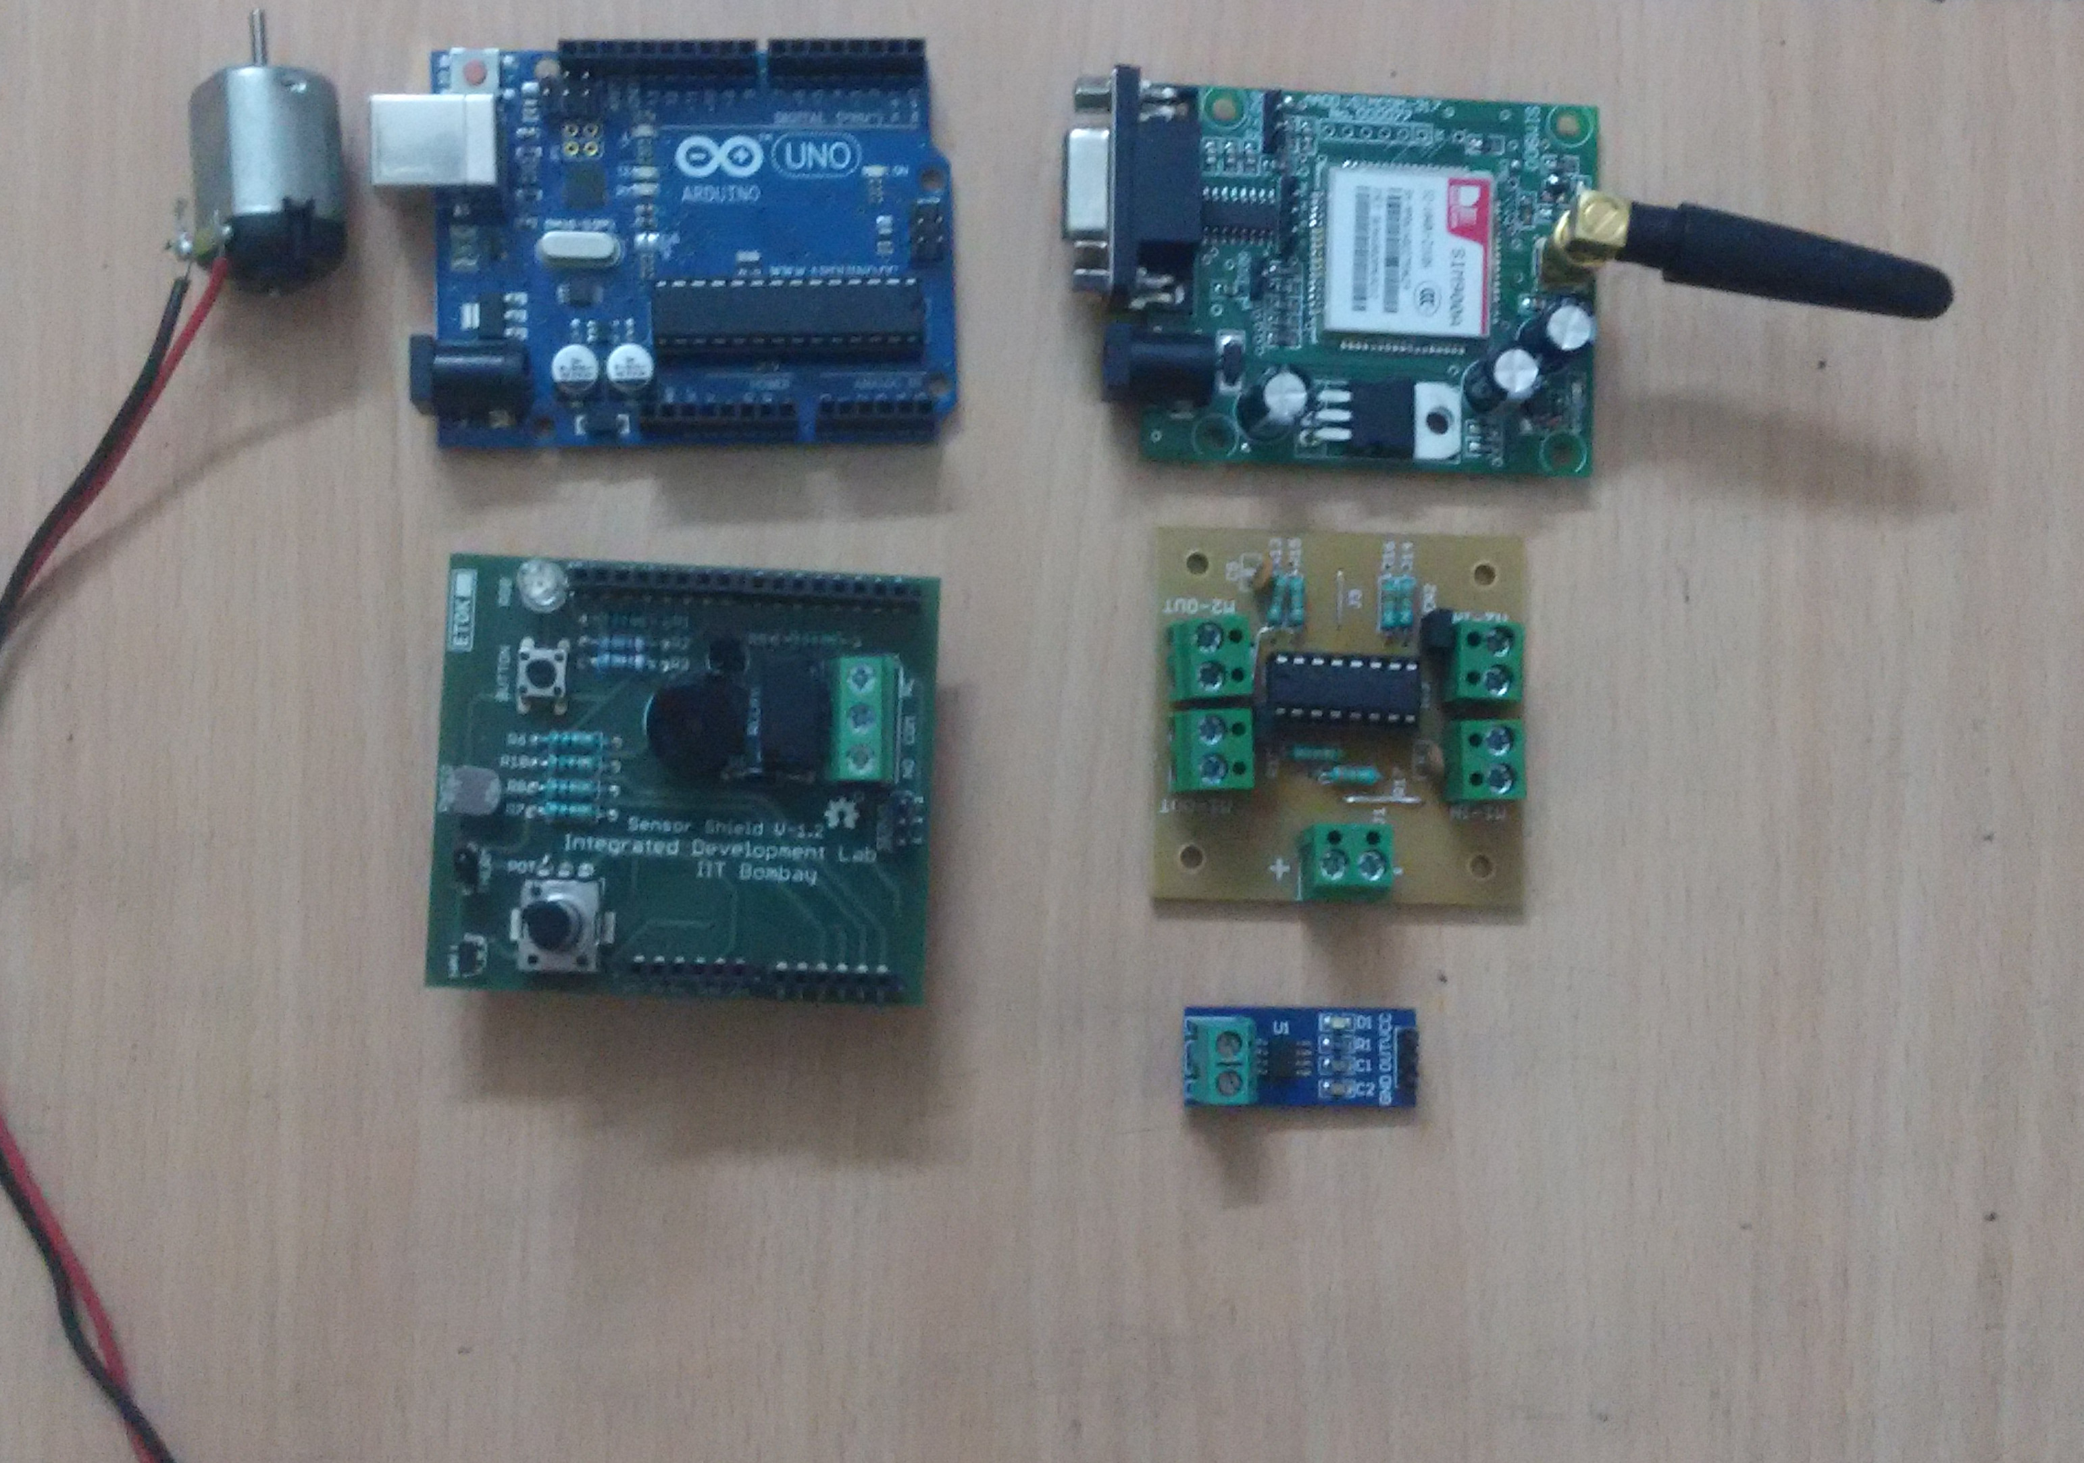
Internet of Things(IoT)
Microcontroller, sensors, actuators

Slide 19
Agreed !
University agreed with thought process.
But you should have to be a Active Contributor for Academia also, such as.
Giving Talks for already made syllabus.
Giving Industrial best practice guideline.
Connecting same domain industries to university.
Document your expertise as standard document for academia where you are contributing.
Make standard practical sessions as a hands-on way, not older way !
Make Content / Document very simple and self – explanatory.

Slide 20
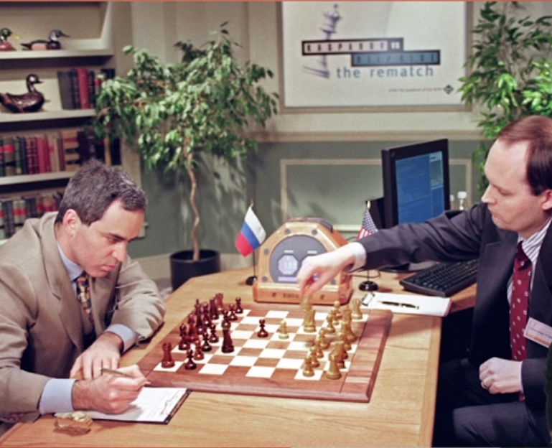
Early Days AI Programs : Deep Blue

Slide 21
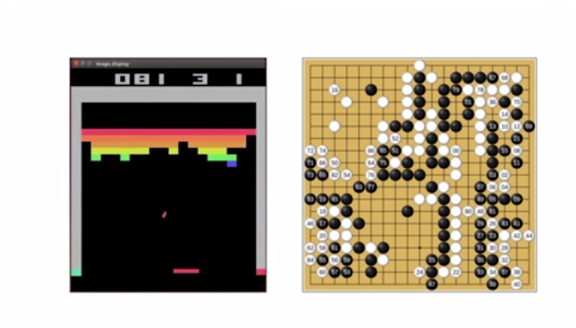
Now, AI Programs
Alpha go is best example, wrote for Playing Go game, but it can play Atari games also.
Face Detection → Car Plat Number Detection

Slide 22
Machine Learning
Machine Learning does this possible, it is study of algorithms which learns from examples and experience having set of rules and hard coded lines.
“Learns from Examples and Experience”

Slide 23

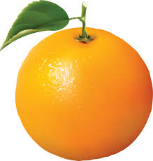
Let's have problem
Let's have problem: It seems easy but difficult to solve without machine learning.

Slide 24

Open Source Libraries

Slide 25


Slide 26
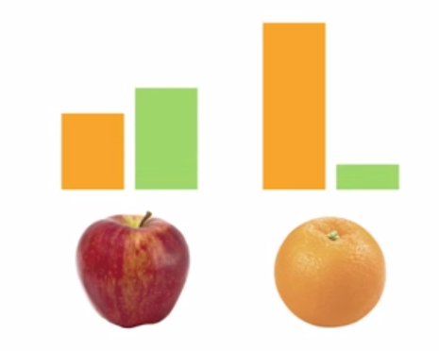

Slide 27
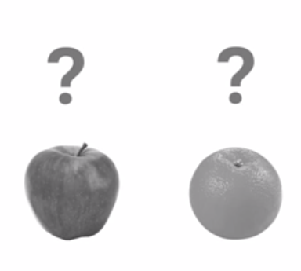

Slide 28
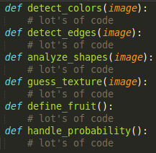

Slide 29

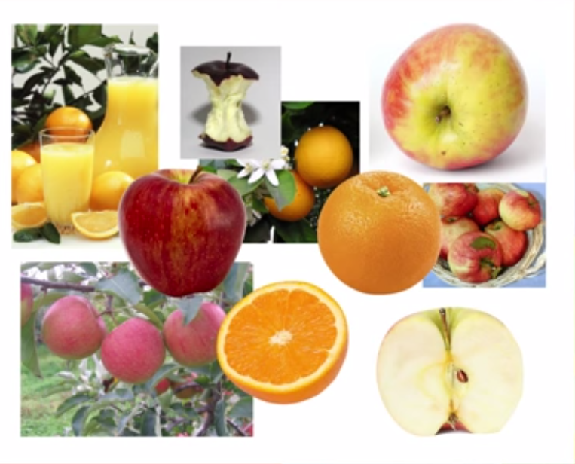

Slide 30
Questions ?

Slide 31
Resources
https://github.com/dskskv/pycon-india-2016
chetan@kutchuni.edu.in
Twitter: @khatri_chetan

